Slide 1



PEILab Group Meeting
Leader: Zicong Hong
Team Member: Jian Lin, Haodong Wang, Qianli Liu, Kaibin Guo, Junjie Liu

Slide 2
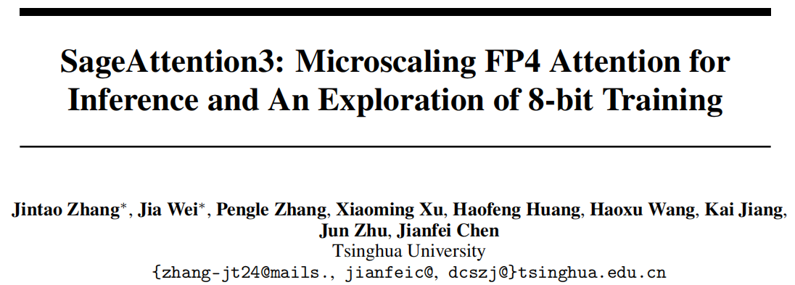
SageAttention3
Arxiv 2025.5

Slide 3
SageAttention3

